Slide 1






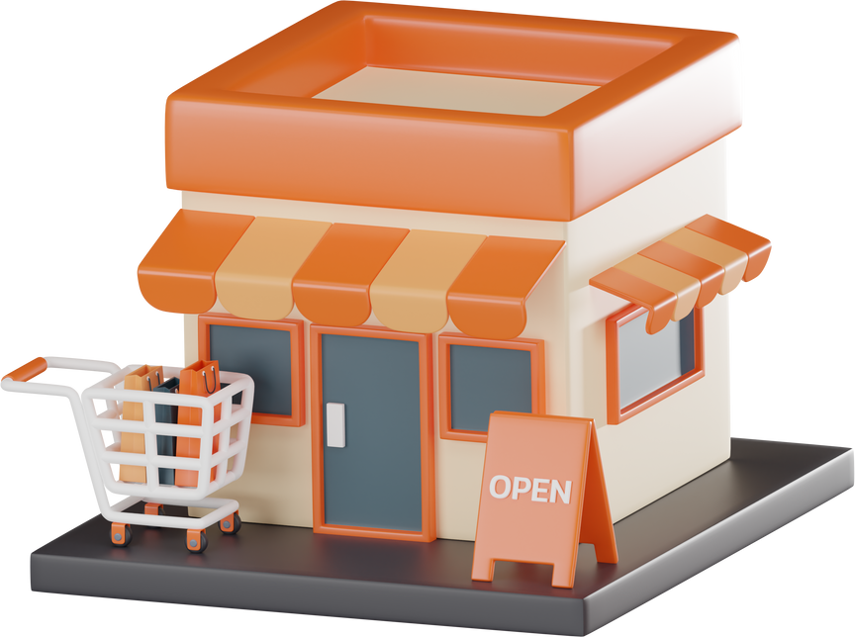
Group
Project
Topic: Superstore Sales Dataset
Presented by:
Team-2
10th June 2025

Slide 2


Group Member
Sakar Rayamajhi
Krishna Kumari Karki
Binod Bhattrai

Slide 3
List of Contents
1.Introduction – Dataset summary & goals
2.Data Profiling
3.Data Quality
4.Visualizations
5.Feature Engineering
6.Key Insights
7.Conclusion + Challenges

Slide 4


1.Introduction – Dataset summary & goals
🗂 Dataset Summary
📁 Dataset: Superstore Sales Dataset (Kaggle)
📍 Scope: U.S.-based retail store sales from 2014 to 2018
📈 Includes key variables like:
Order Date, Ship Mode, Category, Sub-Category
Sales, Quantity, Discount, Profit, Region, Customer Segment
🔢 9800 rows of transactional data
🎯 Project Goals
Understand the structure and quality of the sales data
Identify patterns and relationships (e.g., Sales vs. Profit)
Detect and handle missing values, duplicates, and outliers
Perform meaningful visualizations to gain insights
Engineer new features to support business analysis
Present findings that could help optimize retail strategy

Slide 5

2.Data Profiling
🗃️ Dataset Dimensions
Rows: ~9,800
Columns: 18
🔢 Column Types
🧮 Numerical: Sales,
📅 Date/Time: Order Date, Ship Date
🔤 Categorical: Category, Sub-Category, Segment, Region, Ship Mode
📊 Sample Columns & Description
Column
Order Date
Sales
Profit
Category
Region
Description
Date when the order was placed
Revenue generated by the order
Net profit earned
Product category (e.g., Furniture)
U.S. region of the customer

Slide 6


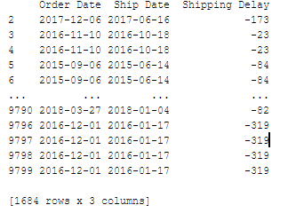
Data Quality Testing and Cleaning
🧩 Missing Values
✅ No missing values found in key columns (Sales, Profit, Category, etc.)
⛔ Minor inconsistencies in Postal Code (11 Postal Code values missing)
📋 Duplicates
🔍 Checked for duplicate rows
No duplicates were found
⛔ Incorrect Data Entry
🔍 One of the major issues
in data quality

Slide 7
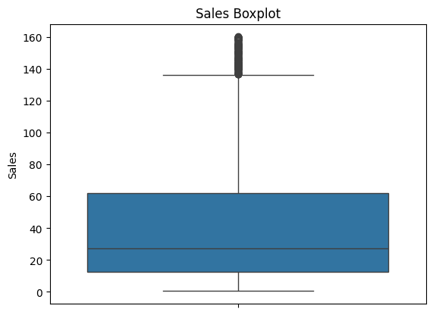
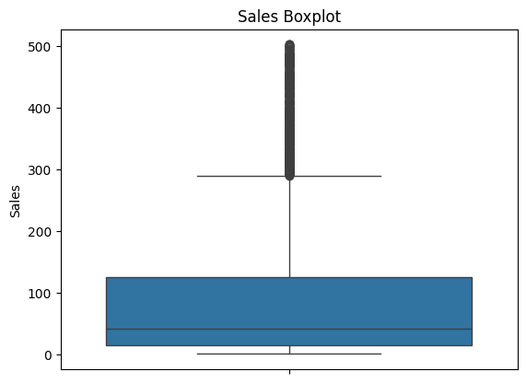
Data Quality
📐 Outliers Detection and Handling
📊 Detected using IQR method and boxplots
🛠️ Outliers mainly in:
Sales (e.g., very high-value orders)
⚠️ Outliers were not always errors — some may be legitimate large orders
Decision: Capped/removed extreme outliers for cleaner visuals

Slide 8
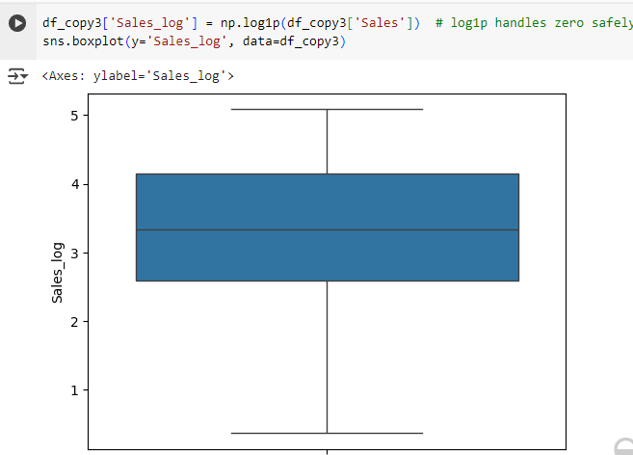
Data Quality
📐 Outliers Detection and Handling (Log Transform)
📌 Final Result
Cleaned dataset with consistent, reliable entries for analysis
No major issues affecting insight generation

Slide 9

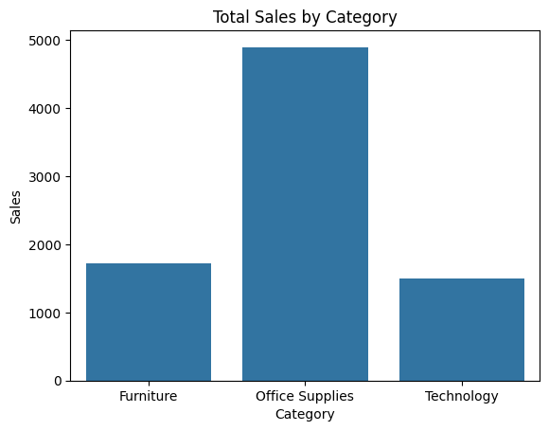
4.Visualizations
Here are 4 key visualizations we used to explore the Superstore dataset:
🔹 1. Sales by Category
countplot comparing total sales across product categories
📝 Insight:
Technology Office Supplies category
generated the highest sales
Furniture and Technology
followed behind
📦 Code
import seaborn as sns
import matplotlib.pyplot as plt
sns.countplot(x='Category', data=df)
plt.title("Total Sales by Category")
plt.xlabel("Category")
plt.ylabel("Sales")
plt.show()

Slide 10
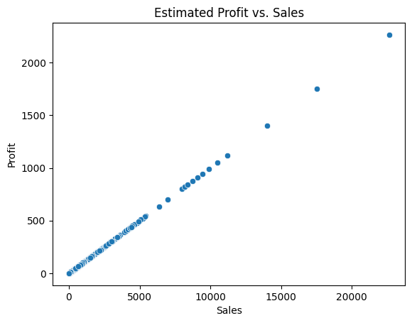
🔹 2. Profit vs Sales (Scatter Plot)
Scatter plot showing the relationship between sales and profit
📝 Insight:
Positive correlation overall
Some sales led to significant losses
(points in lower right)
📦 Code
df["Profit"] = df["Sales"] * 0.1
# Assuming 10% profit margin
df.head(10)
sns.scatterplot(x='Sales', y='Profit', data=df)
plt.title("Estimated Profit vs. Sales")
plt.xlabel("Sales")
plt.ylabel("Profit")
plt.show()

Slide 11
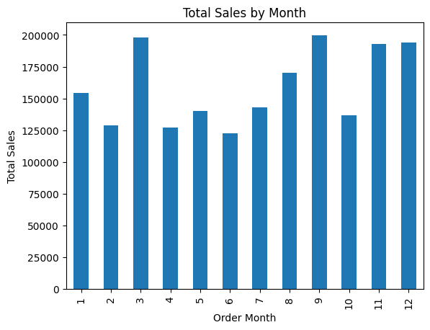
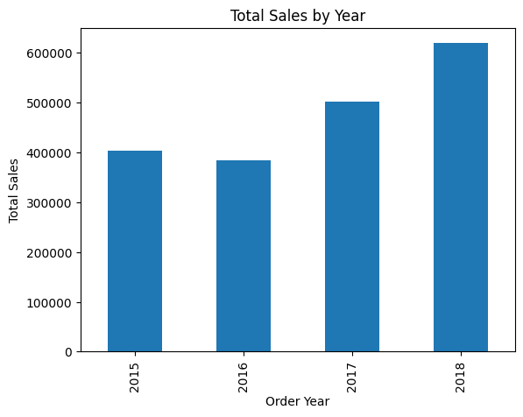

Slide 12
🔹 3. Profit by Region
Boxplot showing profit distribution by region
📝 Insight:
Central region had more variability and several loss-making orders
West and East had more consistent profits
📦 Code:
# Compute the correlation matrix (numeric columns only)
corr= df.corr(numeric_only=True) # True=Show correlation values
sns.heatmap(corr, annot=True, cmap='coolwarm', fmt='.2f') # Format numbers to 2 decimal places
plt.title("Correlation Heatmap") #Values close to +1 → Strong positive,close to –1 → Strong
plt.show()
negative,Values near 0 → Weak or no correlation

Slide 13

🔹 4. Distribution
Histplot showing how often each segment appears
📝 Insight:
Binders and Paper were the most frequently sold items
Fast-moving vs slow-moving items identified
📦 Code
sns.histplot(x='Segment', y='Profit', data=df) #histplot
plt.show()

Slide 14

5.Feature Engineering
🔧 What Is Feature Engineering?
Transforming or creating new variables from raw data to uncover deeper insights and improve analysis.
🔹 Example Feature: Profit Margin
📌 Definition:
A calculated field to show how much profit was made per unit of sales:
Profit Margin=Profit/Sales​
📦 Code:
df['Profit_Margin'] = df['Profit'] / df['Sales']
📊 Visualization:
We can use a boxplot to show margin distribution by category:
import seaborn as sns
sns.boxplot(x='Category', y='Profit_Margin', data=df)
📝 Insight:
Technology not only has the highest sales but also the highest median profit margin.
Office Supplies and Furniture show more variability, with some negative margins (losses).

Slide 15
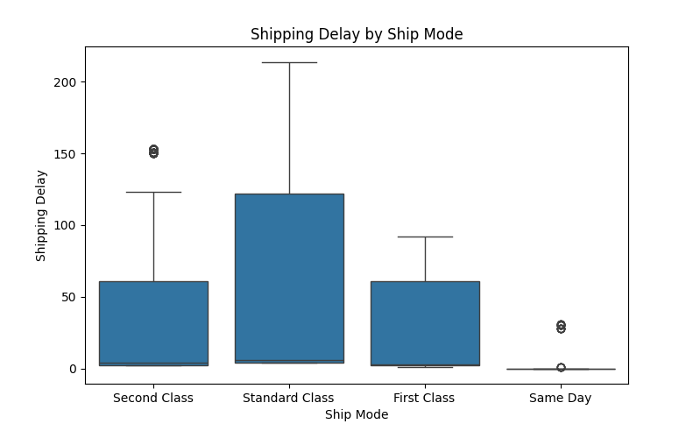
Order Processing Time
📌 Definition:
Time taken to ship an order:
📦 Code:
df['Order Date'] = pd.to_datetime(df['Order Date'])
df['Ship Date'] = pd.to_datetime(df['Ship Date'])
df['Processing_Time'] = (df['Ship Date'] - df['Order Date']).dt.days
📝 Insight:
Faster shipping times might correlate with higher customer satisfaction or lower returns (can be explored in future analysis).

Slide 16
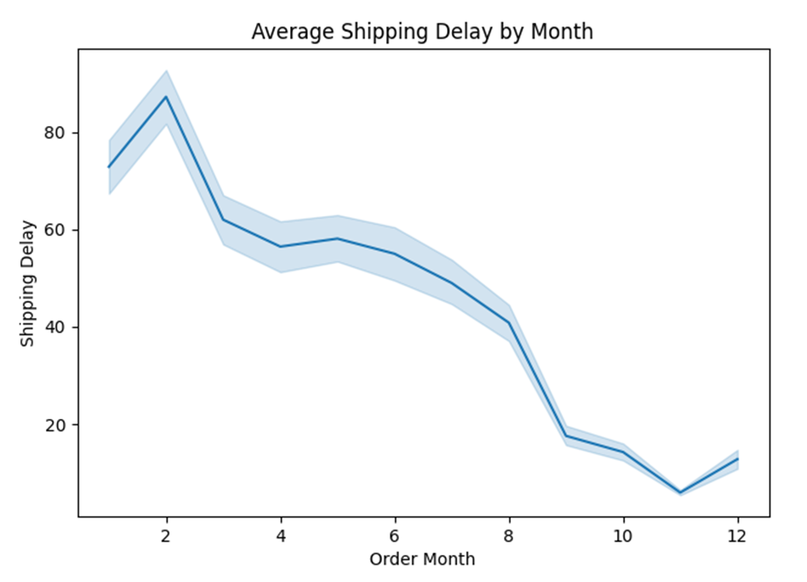
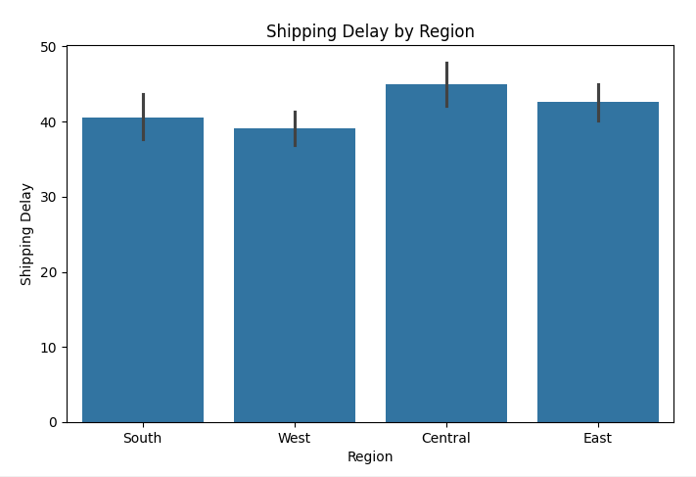

Slide 17
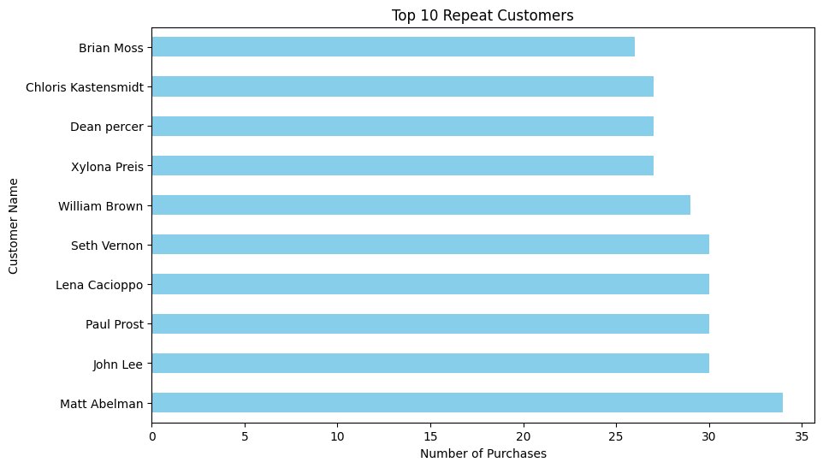

Slide 18
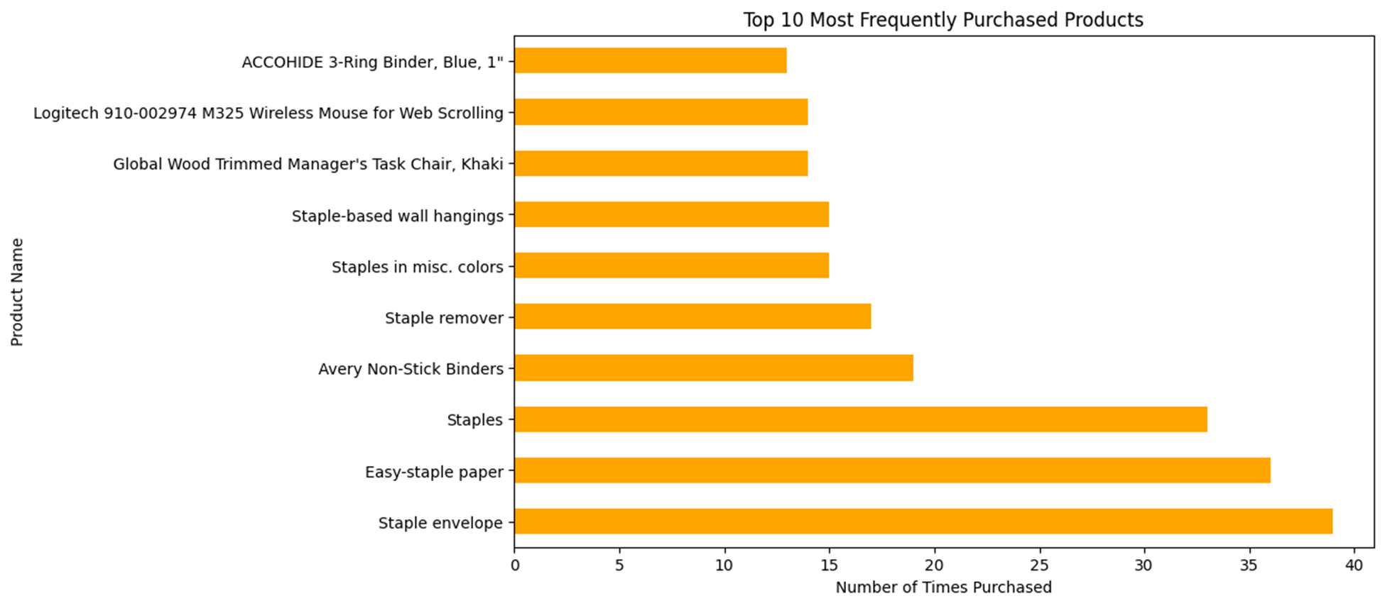

Slide 19


6.Key Insights
What the Data Tells Us
✅ After exploring and analyzing the Superstore dataset, here are 5 key insights we uncovered:
📈 Technology Drives Revenue
The Technology category generated the highest total sales and had the strongest profit margins.
⚠️ Not All Sales Are Profitable
High-value sales do not always result in profit — especially in Furniture, where discounts and shipping costs reduce margins.
🧾 Regional Profitability Varies
The Central region showed inconsistent profit performance, including several large losses, while the West and East were more stable.
🕓 Faster Shipping, Shorter Processing
Most orders are processed within 1–3 days. Regions with longer average processing times may need logistics improvements.
💡 Profit Margin Helps Spot Inefficiencies
By calculating Profit Margin, we identified specific sub-categories (e.g. Tables, Bookcases) that consistently operate at a loss.

Slide 20

7.Conclusion + Challenges
🧾 Conclusion
Our analysis of the Superstore dataset revealed valuable insights about sales, profitability, and customer behavior.
Feature engineering (like Profit Margin and Processing Time) helped highlight inefficiencies and opportunities.
Visualizations helped bring clarity to complex patterns and relationships in the data.
These findings can inform decisions about pricing, inventory, logistics, and strategy.
🚧 Challenges Faced
🔍 Data Quality
Identifying and dealing with outliers that weren’t necessarily errors
🧪 Balancing Simplification vs. Accuracy
Some high-sales items showed losses, but without cost-of-goods data, full profitability analysis was limited
📊 Visual Clarity
Choosing the right chart to represent complex relationships (e.g., multivariable trends like discount vs. profit)
📉 Visual Clarity & Chart Selection
With many overlapping variables (e.g., Sales, Profit, Discount, Region), we had to carefully choose visuals that made patterns easy to interpret.

Slide 21

Does Anyone Have Questions?

Slide 22

Thank You

